Slide 1
Ethereum Phishing User Detection Using Enhanced Temporal Graph Neural Network
Under Guidance of : Joydeep Chandra

Slide 2
Problem Statement
Given a Blockchain Transaction Dataset 𝐷, with transaction records with four tuples [U , A, T ,X], where U = {𝑢1 , 𝑢2 , ..., 𝑢𝑛 } is the set of users, A = {𝑎1 , 𝑎2 , ..., 𝑎𝑛 } defines the set of transactions, T = {𝑡1 , 𝑡2 , ..., 𝑡𝑛 } denotes the set of timestamps of the transactions, and X is the label of users, whether the user is phishing or not. If 𝑢𝑖 = phishing user, X = 1, else 0. A directed transaction network 𝐺 = (𝑉 , 𝐸) is constructed, where, 𝑉 = {𝑣1 , 𝑣2 , ..., 𝑣𝑛 } is the set of users representing the vertices of the network, and 𝐸 = {𝑒1 , 𝑒2 , ...𝑒𝑛 } is the transaction which are utilized as the edges. Transaction direction is considered as the edge direction. We propose a graph-based feature engineering approach for phishing scam detection by considering the following three aspects: (1) transactional patterns of the users, (2) relational activities of the users depending on their sender-receiver relationship, and (3) temporal activities based on transactions’ timestamps. We intend to retrieve an expanded 𝑑 dimensional feature set U𝑖 = {𝑓1 , 𝑓2 , ...𝑓𝑑 } to represent a particular user 𝑢𝑖 in order to classify the users.

Slide 3
introduction
Cryptocurrency & Ethereum
Unlike traditional currencies issued by governments (such as the US dollar or the Euro), cryptocurrencies are typically decentralised and based on blockchain technology. Blockchain is a distributed ledger that records all transactions across a network of computers, ensuring transparency and security.
Ethereum, on the other hand, is a specific cryptocurrency
Ethereum's native cryptocurrency is called "Ether" (ETH).

Slide 4
Transaction
An Ethereum transaction refers to an action initiated by an externally-owned account, in other words an account managed by a human, not a contract.
Focussing on regular transactions.
For example, if Bob sends Alice 1 ETH, Bob's account must be debited and Alice's must be credited. This state- changing action takes place within a transaction.
The transaction object will look a little like this:
{
from: "0xEA674fdDe714fd979de3EdF0F56AA9716B898ec8",
to: "0xac03bb73b6a9e108530aff4df5077c2b3d481e5a",
gasLimit: "21000",
maxFeePerGas: "300",
maxPriorityFeePerGas: "10",
nonce: "0",
value: "10000000000“
}
World state(t)
World state(t+1)
transaction

Slide 5
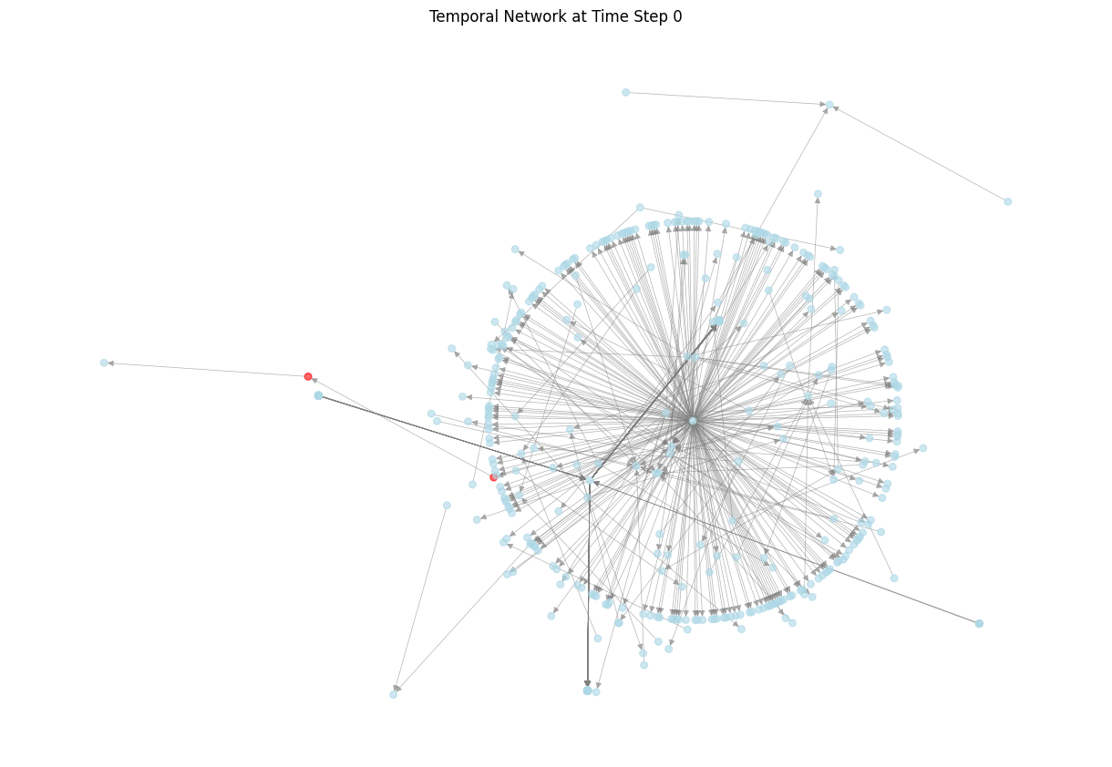
ETHERIUM TRANSACTIONS
Using networkX

Slide 6

Phishing Attacks
phi1
phi2
Phishing attack
Phishing websites and emails are designed to mimic
legitimate Ethereum platforms or services, tricking users into providing their private keys, wallet information, or login credentials. Once obtained, scammers gain control over the victim's funds.
Create Phi Website, Send Fake emails with corrupted URL
Send Phishing address via email, forum, chatting
Loss of sensitive info
User Sends Cryptocurrency to Phishing address

Slide 7
Graph Neural Network
It’s a type of neural network architecture designed to work with data structured as graphs.
Working:
Inputting graph
message passing (node embeddings)
Aggregation / foreword pass
Loss function
Training loop: foreword pass -> loss calculation -> backpropagation -> validation
Evaluation.
Used for:
Link prediction
Node classification
Graph classification etc..
Architectures: GCN,TGN(TGNN),etc..

Slide 8
Temporal Graph Network
Temporal graphs are a type of graph data structure where edges between nodes are timestamped
Tasks that involve time-varying graph data, such as dynamic social networks, financial transaction data…
Designed to capture the temporal dependencies.
WHATS NEW ?
Temporal Aggregation: They incorporate information from past interactions and relationships over multiple time steps.
This aggregation process helps capture the evolving nature of the graph.

Slide 9
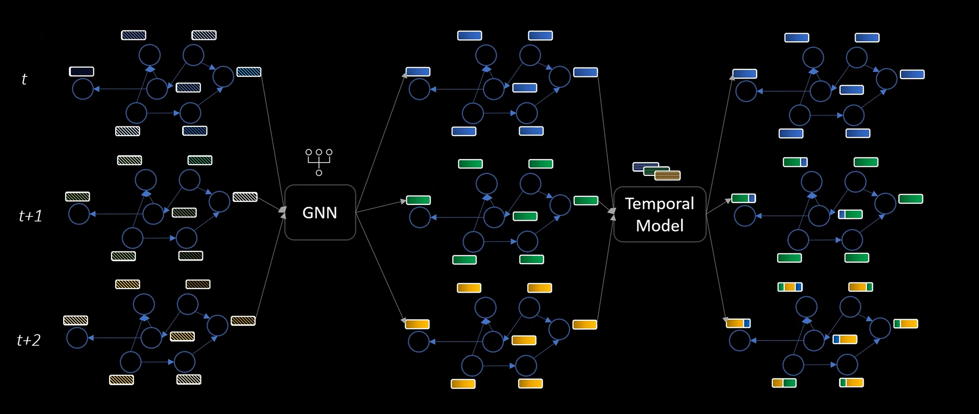
Calculate the graph embeddings for graph at each time stamp Applying some activation and attention mechanism we get spatial features for each node.(MESSAGING) Then we need a model like (LSTM) to store the features of the previous time stamp Now we send the spatial features for each node through this model , The temporal model updates the spatial features of the node with the historical data. The final node embeddings now contain both spatial and temporal features.
STATIC
DINAMIC?

Slide 10
Literature Review:
Year | Title | Venue | Topic
2020 | Detecting Phishing Scams on Ethereum Based on Transaction Records | 2020 IEEE International Symposium on Circuits and Systems (ISCAS) | Transforming to Embedding Space Random Walk-Based Embedding(n2v) focus on preserving local structural characteristics.
2023 | Investigating the Impact of Structural and Temporal Behaviours in Ethereum Phishing Users Detection | Blockchain: Research and Applications | Ttransactional, structural, temporal feature extraction ablation study , classification
2023 | Phishing scams detection via temporal graph attention network in Ethereum | Information Processing and Management | interactions between temporal encoding functions, node features, edge features, and graph topology to effectively model temporal signals. GNN-GCN,GAT graphSAGE/classify
2022 | MT2AD: multi-layer temporal transaction anomaly detection in ethereum networks with GNN | Complex & Intelligent Systems | a series of network snapshots using convolutional encoders with attention mechanisms and pooling operations

Slide 11
Work Done:
Utilised a publicly available real-world Ethereum transactions dataset(D₀). This dataset contains six attributes: 'from', 'to', 'amount' 'timestamp', 'FromIsPhi’, 'ToIsPhi' and added a ‘isPhi’ attribute to it.
Four types of transactions:
Extracted three more datasets namely First-order Transaction Network of Phishing Nodes(D₁)Second-order Transaction Network of Phishing Nodes(D₂). Which were analysed with the The Label of phishing account on Ethereum (D₃),to make it resemble our original dataset (D₀).
FromIsPhi | ToIsPhi | IsPhi
0 | 0 | 0
0 | 1 | 1
1 | 0 | 1
1 | 1 | 1
DataSet | Node Count | 1s (phishing nodes) | 0s (legit nodes)
D0 | 45,868 | 1,262 | 44,606
D1 | 38,792 | 891 | 37,901
D2 | 3,13,806 | 33 | 3,13,773

Slide 12
Work Done:
Preprocessing and execution:
Have divided the dataset into several subsets based on temporal considerations, node sets, and inductive settings. These subsets include:
full_data, train_data, val_data and test_data, new_node_val_data and new_node_test_data
The dataset d0 has been preprocessed as follows,
The dataset has 119998 interactions, involving 45868 different unique nodes
The training dataset has 75446 interactions, involving 24091 different unique nodes
The validation dataset has 17991 interactions, involving 9209 different unique nodes
The test dataset has 17970 interactions, involving 10665 different unique nodes
The inductive validation dataset has 17326 interactions, involving 9169 different unique nodes
The inductive test dataset has 17811 interactions, involving 10618 different unique nodes
4586 nodes were used for the inductive testing, i.e. are never seen during training.
As the dataset that we worked on contains extreme Data Imbalance i.e. a lot more legit transactions than the phishing transactions we could only achieve an accuracy of 50%.

Slide 13
Future Work:
Need to work on improvising the model by applying oversampling techniques and other methods to attain a better accuracy. And also need to work on attention mechanism.
Paper writing

Slide 14
THANK YOU

